Slide 1
Shikhar Microfinance (P) Ltd.
A Pioneer Urban Microfinance Organization Dedicated to Basic Tenets of High Quality Financial Services
Satyavir Chakrapani
Managing Director
113, IInd Floor, Palam Extn.
Gali No-2 (Near ICICI Bank)
Sec.-7, Dwarka
New Delhi-110077

Slide 2
…. Have a “Dream” That One Day….
Pioneer Microfinance in the Ever-growing Urban Centers
Reach the poor & help them lift themselves out of poverty and debt trap
Empower women/family unit
Create livelihoods and transform their lives
Build financially self-sufficient institution
Produce positive, measurable impact
Reach 300,000 urban poor

Slide 3
…. Reality we work in
Our clients -
Have disintegrated and debt trapped family
Land less, shelter less and tenants
No credibility and have no access of services
Without Social Capital and no community
No or weak identity
No or little skills but more opportunities
High cost of living
Debt Trapped ( 60%-800% Annual)
Rampant Child Abuse
Sexual exploitation

Slide 4
…. Our process ……………

Slide 5
The Genesis
Satya, Vinoy and Nitin, three like minded colleagues, teamed up & formed Shikhar Development Foundation.
Objective:
Delivery of innovative microcredit, insurance and other livelihood-enhancement financial products to the ultra-poor urban population
Operation Plan:
Start by addressing needs of NCR and expanding to other North-Indian cities
Original Funding:
Dia Vikas, a subsidiary of Opportunity International Australia, provided the initial funding and technical assistance

Slide 6
I Have A Dream
And as we walk, we must make the pledge that we shall always march forward.
… … … …
You have been veterans of creative suffering. Continue to work with faith that unearned suffering is redemptive. … … knowing that somehow this situation can & will be changed.
Let us not wallow in the valley of despair, I say to you today, my friends.
And even though we face the difficulties of today and tomorrow, I still have a dream. … …
Martin Luther King Jr.
We at Shikhar too have a dream of dawn and new hope for our people and we walk towards it ……………….. Would you …………..!

Slide 7
The Journey
Year | Milestone
May 2007 | Shikhar journey begins
Sept. 2007 | Registration of Shikhar as a trust , followed by Detailed market research
Nov. 2007 | Shikhar starts operations in V.P Singh Camp, Mehrauli Badarpur Road, South Delhi
Dec. 2007 | Disbursement of first micro-credit loan in V.P Singh Camp
Dec. 2007 | Funding from Sadhana Innovative Products & Fin. Serv. Of Rs. 25 lakhs
Mar. 2008 | First Bank funding from Indian Bank of Rs. 10 lakhs
May 2008 | Funding from FWWB of Rs. 10 lakhs
May 2008 | Approval and Funding from Dia Vikas Capital of Rs. 2.7 Crores
Nov. 2008 | SDF Board decides to acquire an NBFC for Microfinance Operations
Feb. 2009 | Approval and Funding from SIDBI of Rs. 50 lakhs

Slide 8
The Journey
Year | Milestone
Jan. 2009 | Partners of Shikhar Trust (POST) a for-Profit SPV as holding company for NBFC registered
Mar. 2009 | Anup Leasing Pvt. Ltd. (ALPL) fully acquired from previous shareholders by POST (59%) & Dia Vikas (40%)
Apr. 2009 | Shikhar implements Progress out of Poverty Index (PPI) with guidance from EDA Rural Systems
Dec. 2010 | ALPL renamed as Shikhar Microfinance Private Limited (SMPL)
Dec. 2010 | SMPL equity enhanced to Rs. 5.12 Cr. with Rs. 2.1 cr. equity infusion from Mi India Capital Pvt. Ltd. (Nijjar Finance Pvt. Ltd.)
Dec. 2010 | SHIKHAR featured as a test case in International media (The Australian) in the midst of the microfinance crisis for the impact made by it in Client lives
Feb. 2011 | Shikhar featured in the national media - Forward Press
Mar. 2011 | Shikhar closes financial year with 66% increase in microfinance assets despite major crisis in the Indian MFI sector

Slide 9
Our Goal
Our Goal is to Provide:
New jobs and income
Access to financial sector generates jobs and income; enable millions of small entrepreneurs
Formal identity & greater personal safety
Establishing banking relationship gives people formal identity they lacked before; thus facilitating the process of political and social inclusion.
Economic empowerment of women
Small credit and insurance cover gives a greater sense of safety and honour. Increased income also enhances the sense of decision making in all family matters including economic
Notes:
9

Slide 10
The Vision
Vision : Empowering communities by providing financial services and livelihood opportunities.
The Road Map
Critical components of financial empowerment :
Credit - Shikhar’s core programme
Insurance – Life with Metlife & Bajaj / Health with Max Bupa
Pension & Secure Investments – NPS Lite (Permission awaited)
Savings – To be implemented with Eko - SBI & ICICI
Financial Literacy – To be implemented with ISMW & other agencies
Critical components of Livelihood Opportunities :
Employment Training Initiative with Elements Akademia, initiatives with United Ways & others in the offing
Water & Sanitation Project

Slide 11
Core Values
Our Resolve is to Create Social Benefits and Promote Financial Inclusion. We Proceed to do so with:
Attention to client needs and focus on quality of service
Integrity & fairness in all transactions
Transparency and deliberate effort to supply relevant information to the clients
Professionalism, engagement of staff with superior ethical conduct and ability
Openness to new ideas and willingness to take
calculated risks

Slide 12
Board Composition and Profile
Board of Directors
S.No | Name | Designation | Qualification and Experience
1 | Mr. Cherian Thomas | Non-Executive Chairman | Over 20 years’ experience in Industry, Banking and Financial Services spanning various functional areas in Citibank, SCICI Limited, ICICI Limited and IDFC COO - IDFC Foundation - overseeing project development & advisory services for both government and corporate clients across the country Member, Management Committee, IDFC. Director on the board of ESAF, a Kerala based MFI working across India
2 | Dr. Shantanu Dutta | Director | Ex-Indian Air Force Medical Officer with rich experience in community health and development Presently working as Executive Director; Oasis India, an International Organization Working on outreach & rescue, transitional care, community empowerment, education & Served many development organizations in different strategic capacities over a period of two decades
3 | Dr. Mallika Chidambaram | Director | An ex-Indian Army Medical officer with two decades of experience in medicine practice Consultant to Integrated HIV & Aids Disease Care Dept. of World Vision Member of various professional bodies like IMA, EMFI and Obstetrics and Gynaecology Society of South India Vast social service experience Serving the refugees in Rameshwaram on a voluntary basis.

Slide 13
Board Composition and Profile
Board of Directors
S. No. | Name | Designation | Qualification and Experience
4 | Mr. Saneesh Singh | Director | Executive Director – Investments at Dia – Vikas. Over 18 years of experience in development banking. Executive development programme from London School of Economics. Fullbright scholar.
5 | Ms. Ragini B Choudhary | Director | Head Operations, Mi India Capital. PG from Institute of Rural Management, Anand (IRMA), India & member of the Chartered Institute of Management Accountants (CIMA), UK. Carries over 8 years of experience in trainings on various aspects of development finance.
6 | Mr. Satyavir Chakrapani | Managing Director & CEO | Management Graduate from the Entrepreneurship Development Institute of India (EDII) with over 15 years of development sector experience Worked with World Vision India and Shramik Bharti Consultant with various e-governance projects and ICT initiatives during his career with One World South Asia, Emmanuel Hospital Association and other developmental agencies Part of various task-forces on policy and guidelines’ reviews and has to his credit various publications and papers on developmental and community issues Recipient of the NABARD scholarship during the postgraduate program
7 | Mr. Vinoy Thomas | Director & CFO | Management graduate with over 10 years of corporate experience including infrastructure consulting, advisory, financial modeling and analysis Headed the Tourism, Urban and Social sector portfolio in his assignment with IDFC’s advisory firm, U-DeC, Dehradun

Slide 14
Our Partners at a Glance
.
Initial Funding Support | Board Members
Base Funding Source | DIA VIKAS CAPITAL PVT. LTD. (Opportunity International, Australia)
Other Funding Sources | Ananya Finance (previously Friends of Women’s World Banking, India), Maanaveeya (Oikocredit India)
Bank Funding | SIDBI, HDFC Bank, Axis Bank, United Bank of India, Development Credit Bank, Indian Bank,
Technical Support | Microsave, India EDA Rural Systems Opportunity International, Australia FWWB
Bankers | HDFC Bank, ICICI Bank, Axis Bank, State Bank of India
Insurance Partners | Bajaj Allianz, MetLife, Birla Sunlife,

Slide 15
Outreach & Performance (Dec. 2011)

Slide 16
SHIKHAR Operations
Br.13 Area – Narela
Br.7 Area - Bhalswa
Br.3 Office - Khajuri
Br.8 Office - Tahirpur
Br.10 Area – Nangloi
Br.5 Area – Uttam Nagar
Br.2 Office – Hassanpur / Br. 11 Office - Noida
Br.9 Office – Ghaziabad
Shikhar Main Office
Br.1 Area
Br.1 Office - Badarpur
Br.1 Area
Br.4 Area - Faridabad
Br.12 Office – Ballabgarh – Br. 14 - Palwal

Slide 17
Shikhar Operational Areas
Shikhar’s area of operations include Badarpur, Hassanpur, Khajuri Khaas, Faridabad, Uttam Nagar, Vasant Kunj, Tahirpur, Ghaziabad, Nangloi, Narela, Ballabhgarh, Noida and Bhalaswa.
Branch Code | Branch Name | District
NCR 01 | BADARPUR | SOUTH DELHI
NCR 02 | MAYUR VIHAR | EAST DELHI
NCR 03 | KHAJURI | NORTH EAST DELHI
NCR 04 | FARIDABAD | FARIDABAD
NCR 05 | UTTAM NAGAR | WEST DELHI
NCR 06 | VASANT KUNJ | SOUTH DELHI (Being merged with NCR 01)
NCR 07 | BHALASWA | NORTH DELHI
NCR 08 | TAHIRPUR | NORTH EAST DELHI
NCR 09 | GHAZIABAD | GHAZIABAD
NCR 10 | NAGLOI | WEST DELHI
NCR 11 | NOIDA | NOIDA
NCR 12 | BALLABHGARH | BALLABHGARH
NCR 13 | NARELA | WEST DELHI
NCR 14 | PALWAL | PALWAL (Started very recently)

Slide 18
Shikhar Operational Progress
Operational Indicators
For the period ended / As on | Units | 31-Dec-11 | 31-Mar-11 | 31-Mar-10 | 31-Mar-09
Groups | No. | 3005 | 2448 | 2016 | 887
Total Membership | No. | 23977 | 15403 | 10722 | 4862
Borrowers | No. | 15022 | 12384 | 10601 | 4530
Active Loans | No. | 15022 | 12384 | 11516 | 4658
Branches | No. | 13 | 13 | 10 | 6
Loan Officers | No. | 46 | 56 | 45 | 48
Areas covered | No. | 121 | 114 | 54 | 38
Borrowers/ branch | No. | 1046 | 953 | 1060 | 94
Borrowers/Loan Officer | No. | 324 | 221 | 247 | 94
Women borrowers | % | 98 | 100 | 100 | 100
Repayment rate | % | 96.77 | 97.34 | 97.47 | 100%
Commulative Disbursements | Rs. Cr | 36.4 | 27.27 | 11.75 | 3.43
Total loan outstanding | Rs. Cr | 11.66 | 8.57 | 5.32 | 2.14

Slide 19
Growth Projections
 | FY 11-12 | FY12-13 | FY 13-14 | FY 14-15 | FY 15-16
Active Loan Clients | 18,034 | 41,201 | 86,503 | 1,26,806 | 1,52,109
Portfolio Outstanding | 18.65 | 41.77 | 61.76 | 94.39 | 124.92
No. of Branches | 13 | 23 | 30 | 45 | 54
Case Load per FE | 350 | 450 | 500 | 550 | 600
OSS | 100 % | 112.52 % | 113.10% | 114.95 % | 119.98 %

Slide 20
Few Achievements

Slide 21
Organisational Structure
Share-holders
Board of
Directors
Chief Executive Officer /
Managing Director
Audit &
Internal Control
Operations Manager
Chief Financial Officer
HR/Admin Manager
Operations Manager (NCR)
Accounts & Finance Manager
Admin Executive
Operations Executive
Bus: Development Executive
Accounts Executive
Office Assistant
Branch Manager
MIS Executive
Manager - Social Intermediation
Trainee Branch Manager
Office Assistant
Field Executive
Senior Field Executive
Trainee Field
Executive

Slide 22
Non-Financial Services
Community Empowerment and Enrichment Program
Financial Literacy
Enterprise Development
Let her Live
Child Health and Nutrition

Slide 23
Urgent Tasks @ Hand
Attract and retain suitably qualified and trained human resources
Deploy efficient IT solutions that facilitate efficient operations and mitigate inherent operating risks to the extent possible
Equity for microfinance operations
Grant funding for other community transformational services; e.g. Health Financing, Financial and value education, community against female feticide, Child Nutrition, Enterprise and skill development resource center

Slide 24
Where have we reached
Families are Redeemed from debt trap
People have an Identity
Sustainable businesses are built
People have safe homes
Families stay together
Children are safer
Children go to school
Communities are built
Transformation is under way

Slide 25
Challenges
We are Prepared to Face the Following Challenges:
Ability to access loan funds at a reasonably low rates of interest & raise equity
Ability to expand the geographical & demographic reach
Ability to devise & provide wider range of financial products
Ability to attract and retain professional and committed human resources. i.e. Ability to enhance efficiency
Ability to innovate in the midst of enhanced political risks and depressed global economic outlook

Slide 26
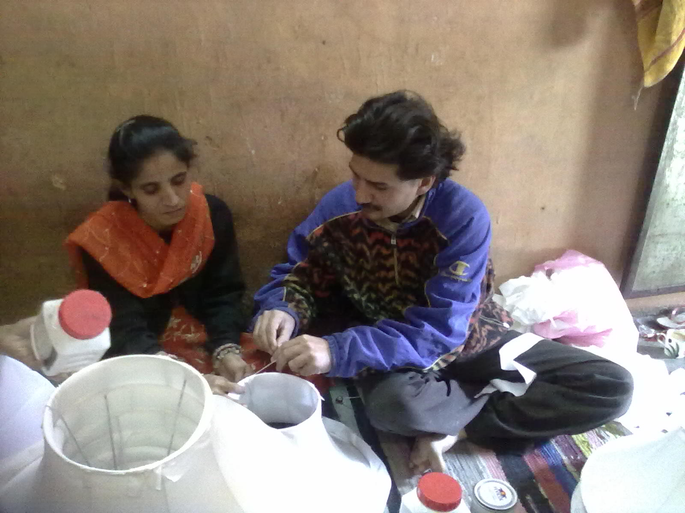
And we are marching on to realize the dream
Beena with her husband have build family business , they work together and they live together

Slide 27
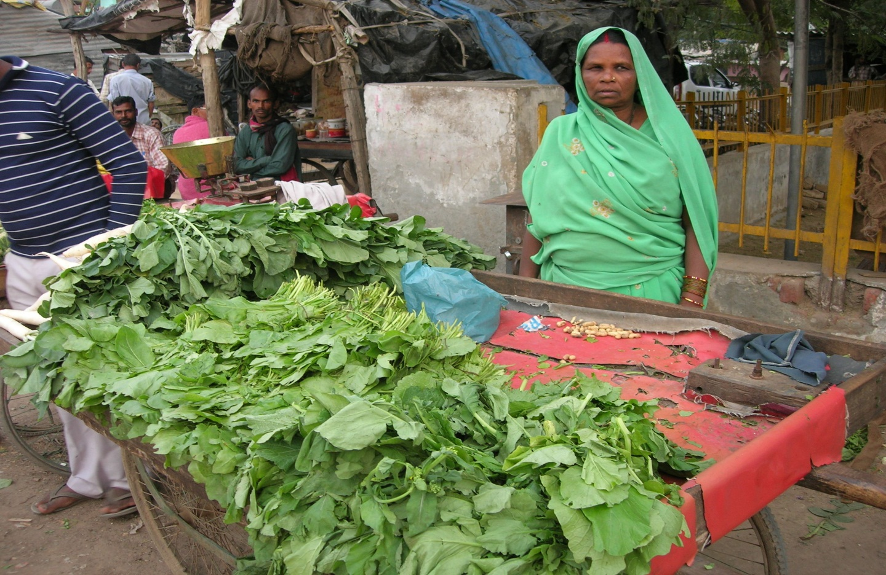
And we are marching on to realize the dream …………………
It is not green vegetables cart but has brought greenery in family life. Champa Devi from domestic help to an entrepreneur.

Slide 28
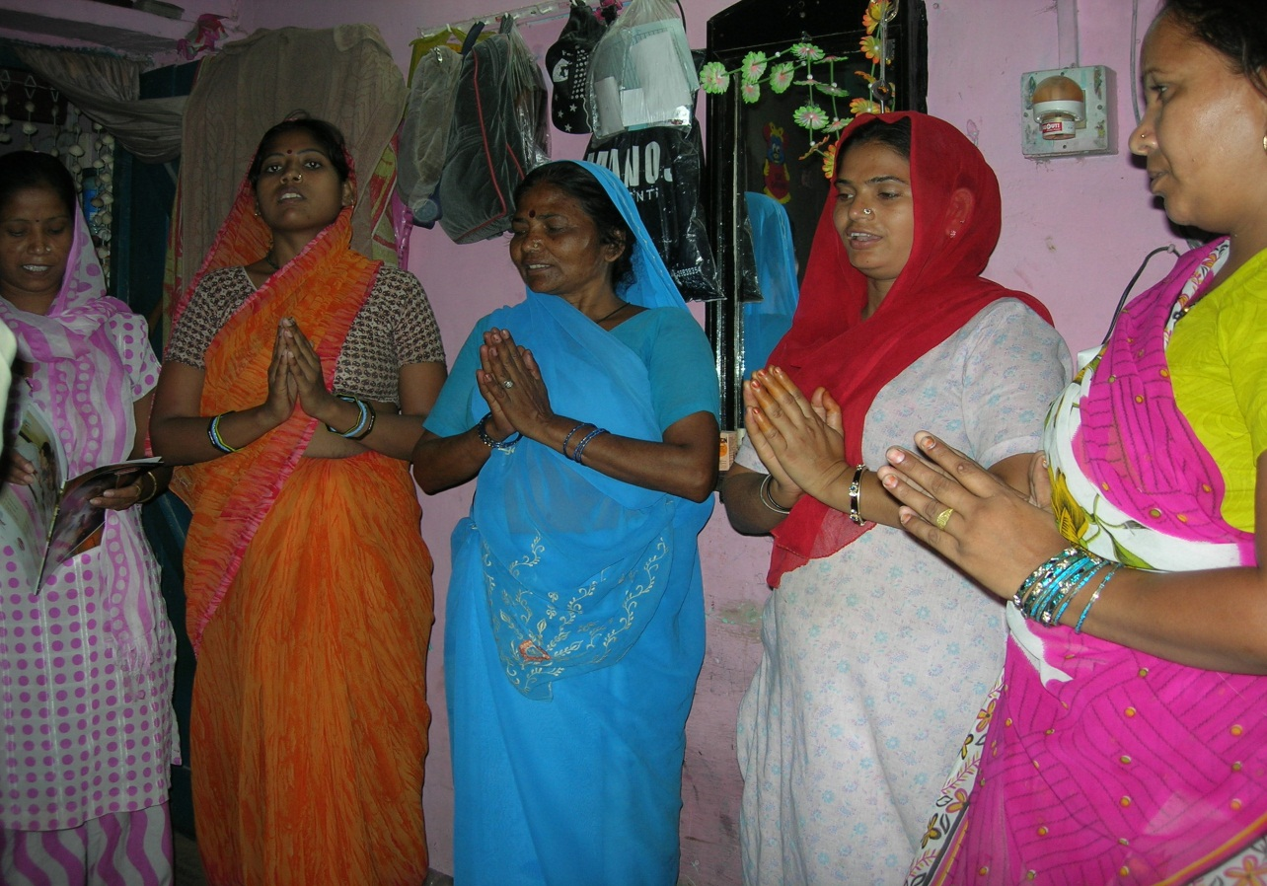
And we are marching on to realize the dream …………………
We are a new family and new community. Together we will change………

Slide 29
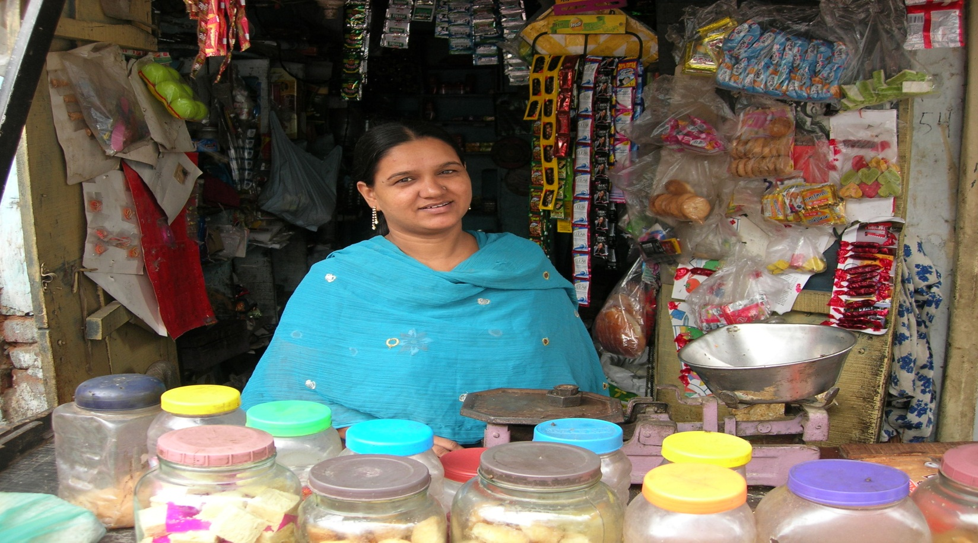
And we are marching on to realize the dream …………………
I am a business woman ………..

Slide 30
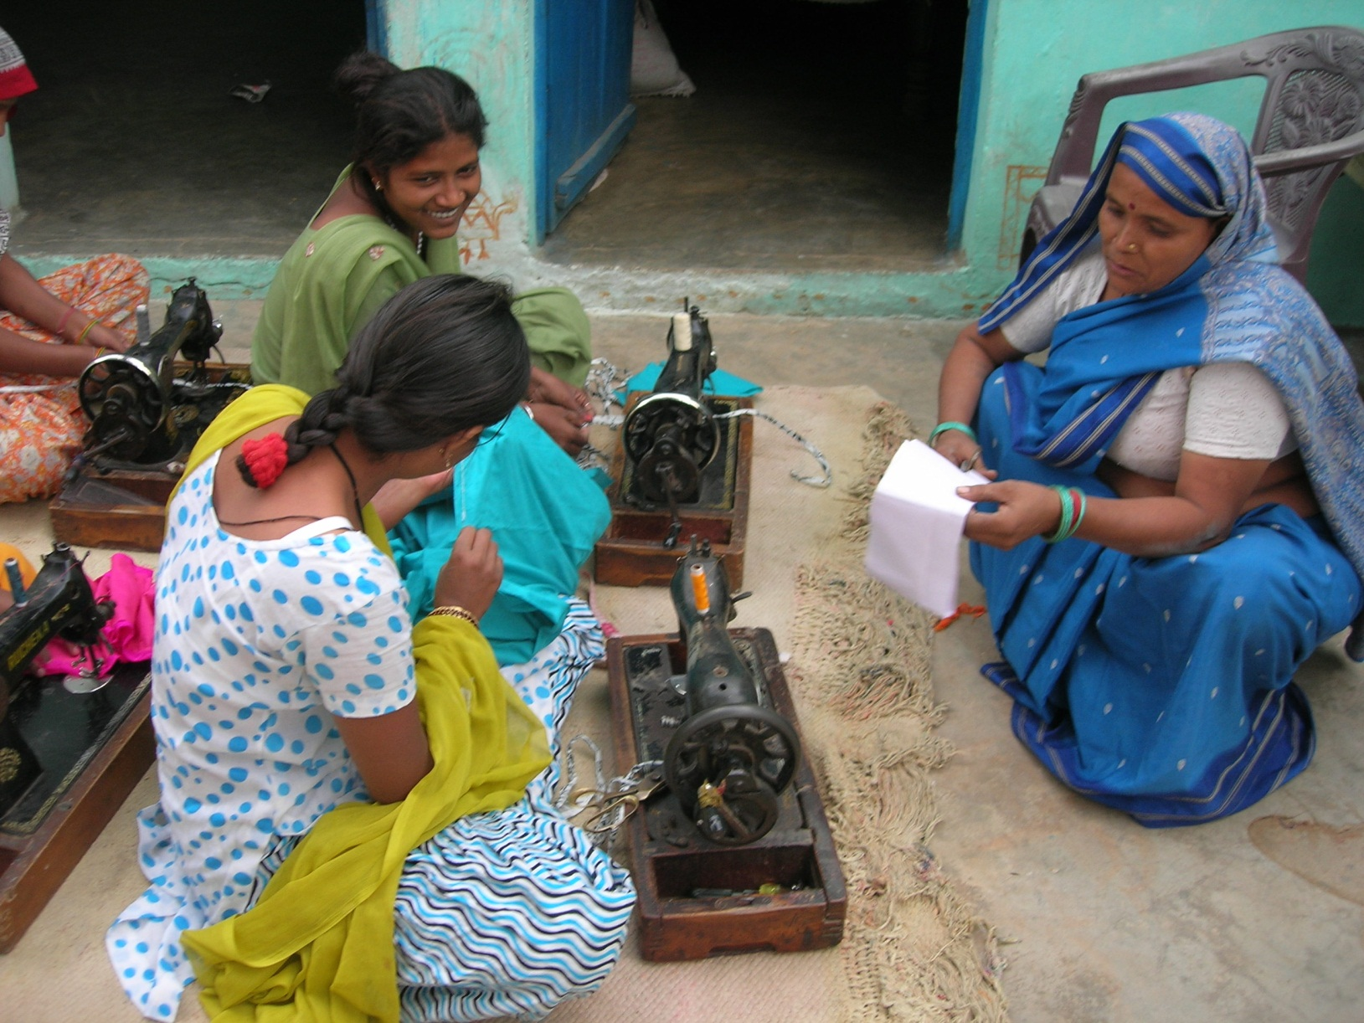
And we are marching on to realize the dream …………………
I am a job creator ……….. Pushpa from Dayal Nagar

Slide 31
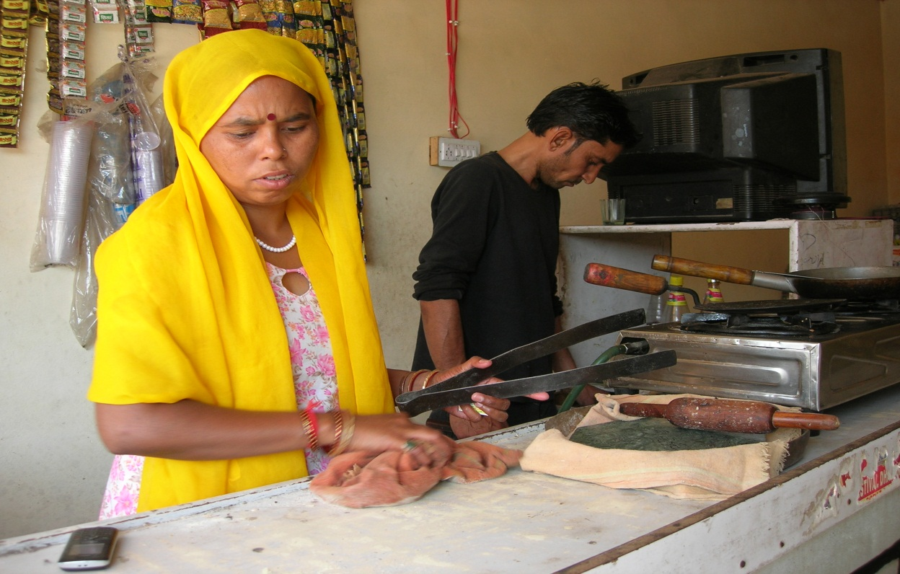
And we are marching on to realize the dream …………………
We do it together……Kavita and Sanjay

Slide 32
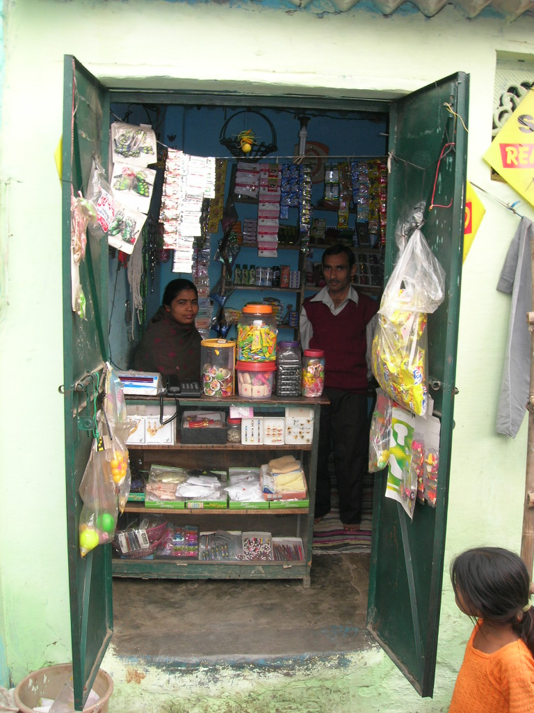
And we are marching on to realize the dream …………………
No more separate ……………………. Rukmani and Lallan Jha

Slide 33
Thank You

